Slide 1

NRI living in UAE should invest in Max Life Insurance
Presentation By
N N Mathur - +91-9811261602
+91-11-41601701

Slide 2


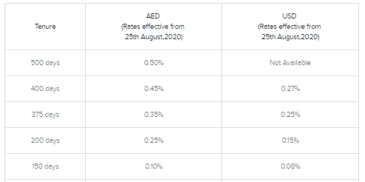
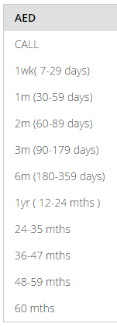

If NRI invests in Fixed Income Instruments in UAE
Rate of Return in UAE’s Bank Term Deposits: 0.50%

Slide 3


If NRI invests with Max Life Insurance in India
If NRI invest in Traditional Life Insurance Policy
  > Rate of Return : 6% p.a.*
  * Average returns on Traditional par products of Max Life Insurance
Tax on Life Insurance investments in India
Returns from a Traditional policy of a Life Insurance company are not taxable
as per Indian Income Tax laws.
Therefore, NRI has to pay no tax in India as well as in UAE.
Disclaimer: Taxation rules stated here are as per best of our knowledge and understanding. Max Life Insurance does not guarantee any tax benefits.

Slide 4
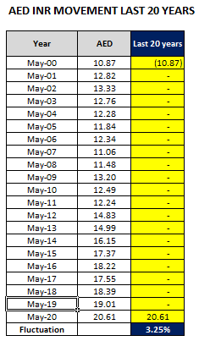
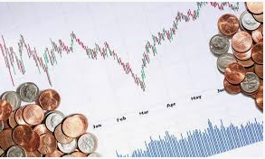
Impact of currency fluctuation between AED & INR
  Considering last 20 years data, INR has depreciated by ~ 3.25% p.a. to AED, see below table:
  Net Impact of currency fluctuation (-) 2.60% p.a.*(i.e. 3.25% - 20% for averaging-out premiums)

Slide 5


Summary
 | UAE | India
Rate of Return | 0.50% | 6.00%
Impact of currency fluctuation | 0% | -2.60%
Pre-Tax Return | 0.50% | 3.40%
Income Tax Rate | 0% | 0%
Net Rate of Return | 0.50% | 3.40%

Slide 6

Unique Proposition for NRIs/OCIs by Max Life
NRIs/OCIs can buy while in his country of residence – E model cases
Easy documentation for NRI/OCI proposal forms
Max Life accepts Foreign Currency for premium; easier for NRIs/OCIs
Exemption to NRIs/OCIs from paying GST on life insurance premium if premium received in AED or paid from their Indian NRE/FCNR account
Easy remittance of claims for NRIs/OCIs. If premium paid in AED, then maturity/withdrawal can be taken in AED or any currency of choice; no mandatory requirement of having a Indian bank account

Slide 7

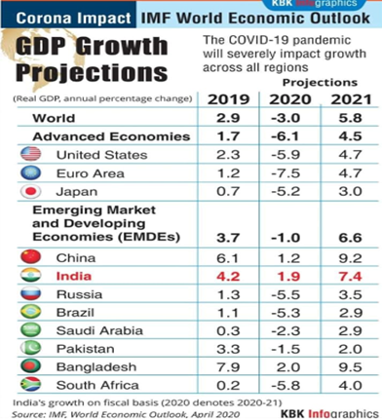
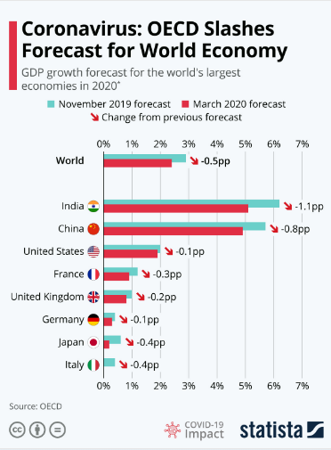
Why should NRI Invest in India
Higher GDP Growth prediction than other developed countries

Slide 8

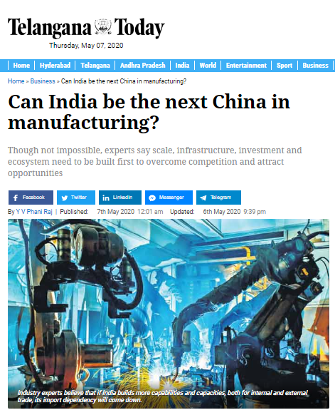

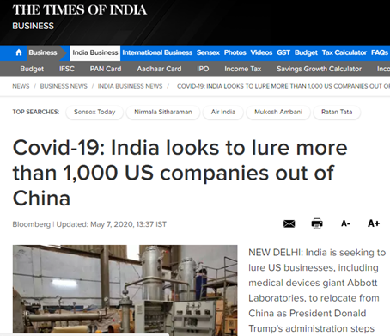

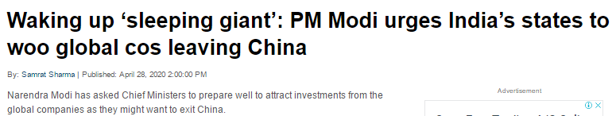
Why should NRI Invest in India
Positive outlook ahead as more foreign companies to invest in India

Slide 9

Why should NRI Invest in India
Indian Equity market has outperformed world equity market in past
Past 15 years
Date | BSE Sensex | FTSE 100 | NYSC Composite | Nikkei 225 | Dow Jones | Hang Seng | Straits Times
Jan’ 2005 | 6626 | 4814 | 7250 | 11458 | 10784 | 14216 | 2065
Dec’ 2019 | 41254 | 7542 | 13913 | 23771 | 28538 | 28190 | 3223
Annualized return | 12.96% | 3.04% | 4.44% | 4.98% | 6.70% | 4.67% | 3.01%
Past 20 years
Date | BSE Sensex | FTSE 100 | NYSC Composite | Nikkei 225 | Dow Jones | Hang Seng | Straits Times
Jan’ 2000 | 5210 | 6930 | 6762 | 18937 | 11502 | 17058 | 2502
Dec’ 2019 | 41254 | 7542 | 13913 | 23771 | 28538 | 28190 | 3223
Annualized return | 10.89% | 0.42% | 3.67% | 1.14% | 4.65% | 2.54% | 1.27%

Slide 10

Why should NRI Invest in India
Higher interest rates in India at present than other countries
India | USA | UK | UAE | Australia | New Zealand | Singapore | China
6.00% | 0.06% | 0.35% | 0.50% | 1.00% | 1.30% | 1.40% | 2.75%
*Maximum Interest rates offered by leading Banks for Term Deposits

Slide 11
Products

Slide 12



Smart Wealth Plan –Lump sum Benefit Option
Need
Identified:
Build a corpus
for his
Daughter’s
Education
Daughter’s
Details:
Name: Ria
LI Age: 2 Years
Solution:
Max Life
Smart
Wealth
Plan
Mr. Ravi,
Age: 35 Years
PPT: 8 years
PT: 16 years
Premium:
10 Lac p.a.
Mr. Ravi & his Daughter
Policy
Commencement
Policy Term
Ends
1
2
3
8
. . . . . . . . .
Age:
35 Years
Age:
51 Years
. . . . . . . .
Rs. 1,60,67,600
(Rs. 1.60 cr)
Guaranteed Maturity Benefit
Annual Premium Paid = Rs. 10 Lac
Total Premium Paid in 8 years (10*8) = Rs. 80 Lacs

Slide 13



Smart Wealth Plan - Long Term Income Benefit Option
Need
Identified:
Wants guaranteed
income to fulfill his
Early Retirement
needs
Solution:
Max Life
Smart
Wealth
Plan
Mr. Agrim,
Age: 35 Years
PPT: 10 years
Premium:
5 Lacs p.a.
Mr. Agrim
Rs. 4.74 Lacs of Guaranteed Income every year for 25 Years
+ Rs. 50 Lacs as Terminal Benefit
Policy
Term
Ends
+
1
2
3
. . . . . . . . . . . . . . . . . .
10
. . . . . . . . . . . . . . . . . . .
12
15
16
. . . . . . . . . . . . . . . . . . .
36
Terminal Benefit (Total Premiums Paid)
Age:
35 Years
. . . . . . . . . . . . . . . . . .
Age:
71 Years
Annual Premium Paid = Rs. 5 Lac
Total Premium Paid in 10 years = Rs. 50 Lacs

Slide 14








MONTHLY INCOME ADVANTAGE PLAN
LIVING BENEFITS
Guaranteed Monthly Income for 10 years = Rs 1,25,000
Annualized Premium : Rs 10,03,500
Total Premium Paid: Rs 12,042,000.00
Lump- sum payable at Maturity
@4% = Rs 9,73,896
@8% = Rs 1,19,22,959
Year 1
Age: 35 years
Year 13
Age: 47 years
Year 22
Age: 56 years
End of Premium Paying term
Death benefit = 1,50,00,000
Guaranteed Monthly Income for 10 years = Rs 1,25,000
DEATH BENEFITS
Lump- sum payable at Maturity
@4% = Rs 9,73,896
@8% =Rs 1,19,22,959
Annualized Premium : Rs 10,03,500
Total Premium Paid: Rs 5,017,500
Future premiums due from year 6 to year 12 are waived off by Max life
Year 1
Age: 35 years
Annualized Income :Rs 15,00,000
Total Income : Rs 150,00,000
Year 5
Age: 40 years
Year 13
Year 22
End of Premium Paying term

Slide 15


Platinum Wealth Plan – 5 Pay 10
Name: Rahul
Age: 35
Male; Non Smoker
Annual Premium : Rs 10,00,000
Total Premium : Rs 50,00,000
End of Premium Paying Term
Maturity Benefit @8% : Rs 81,00,405
Year 1
Year 5
Year 10
Age: 35
Age: 40
Age: 45
Annual Premium : Rs 10,00,000
Total Premium : Rs 50,00,000
End of Premium Paying Term
Death Benefit: Rs 1,00,00,000
Year 1
Year 5
Year 10
Age: 35
Age: 40
Age: 45
6

