Slide 1

NRI living in Singapore should invest with Max Life Insurance
Presentation By
N N Mathur, Founder- https://thesafetypoint.com
- +91-9811261602
+91-11-41601701

Slide 2


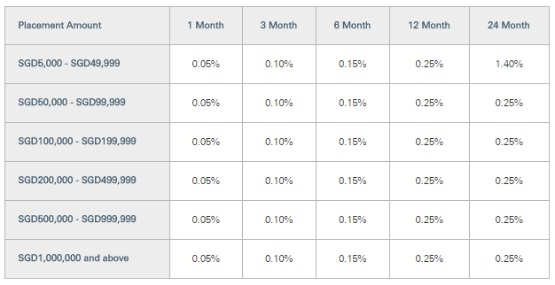

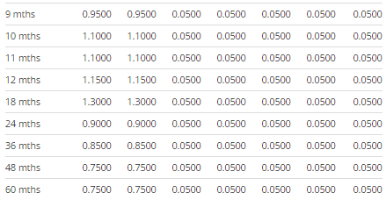
If NRI invests in Fixed Income Instruments in Singapore
Rate of Return in Singapore’s Bank Term Deposits: 1.40%

Slide 3
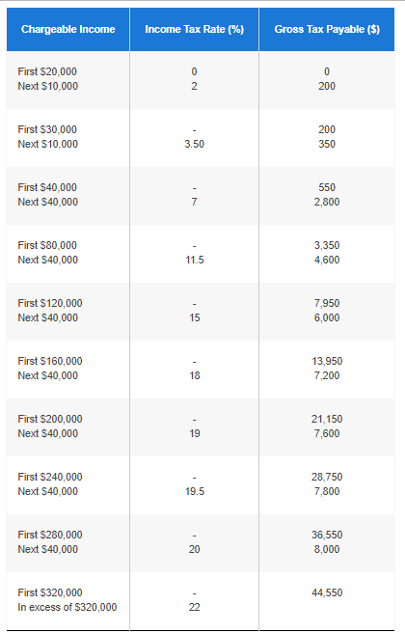
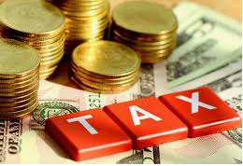
Taxation on Returns on investment in Singapore
Average Income Tax Rate in Singapore: 15%#
# NRI has to pay tax on returns from Bank Deposit in Singapore as per prevailing Personal
Income Tax Rates as per below table for the year 2020:
Disclaimer: Taxation rules stated here are as per best of our knowledge and understanding. Max Life Insurance does not guarantee any tax benefits.

Slide 4


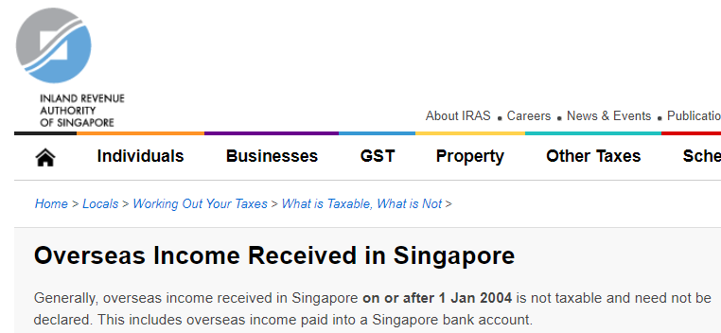
If NRI invests in Life Insurance in India
If NRI invest in Traditional Life Insurance in Products in India
  > Rate of Return : 6% p.a.*
  * Average returns on Traditional par products of Max Life Insurance
  If NRI invest in Traditional Life Insurance in Products in India
  > Income Tax Rate : 0% #
#Life insurance proceeds are not taxable in Singapore, if invested in a Life Insurance company outside Singapore (overseas Income); therefore, nothing is taxable.
Singapore govt. website URL - >
https://www.iras.gov.sg/IRASHome/Individuals/Locals/Working-Out-Your-Taxes/What-is-Taxable-What-is-Not/Overseas-Income-Received-in-Singapore/
Disclaimer: Taxation rules stated here are as per best of our knowledge and understanding. Max Life Insurance does not guarantee any tax benefits.

Slide 5
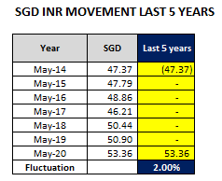
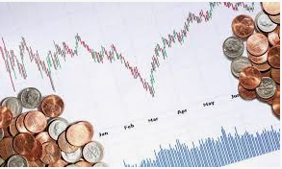
Impact of currency fluctuation between SGD & INR
  * Considering last 5 years data, INR has depreciated by ~2% p.a. to SGD, see below table:
Net Impact of currency fluctuation (–) 1.60% p.a.* (i.e. 2% - 20% for averaging-out premiums)

Slide 6


Summary
 | Singapore | India
Rate of Return | 1.40% | 6.00%
Impact of currency fluctuation | 0% | -1.60%
Pre-Tax Return | 1.40% | 4.40%
Income Tax Rate | 15% | 0%
Net Rate of Return | 1.19% | 4.40%

Slide 7

Unique Proposition for NRIs/OCIs by Max Life
NRIs/OCIs can buy while in his country of residence – E model cases
Easy documentation for NRI/OCI proposal forms
Max Life accepts Foreign Currency for premium; easier for NRIs/OCIs
Exemption to NRIs/OCIs from paying GST on life insurance premium if premium received in SGD or paid from their Indian NRE/FCNR account
Easy remittance of claims for NRIs/OCIs. If premium paid in SGD, then maturity/withdrawal can be taken in SGD or any currency of choice; no mandatory requirement of having a Indian bank account

Slide 8

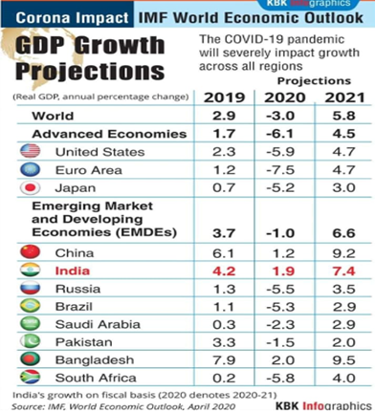
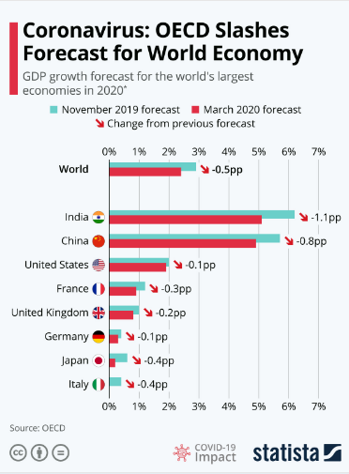
Why should NRI Invest in India
Higher GDP Growth prediction than other developed countries

Slide 9


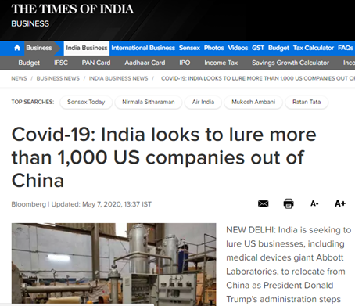
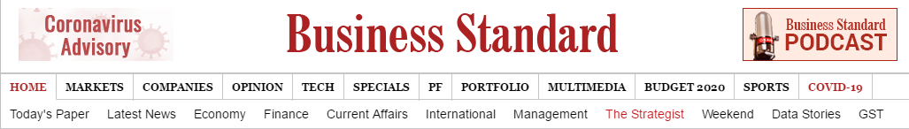
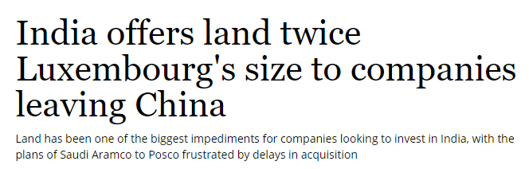
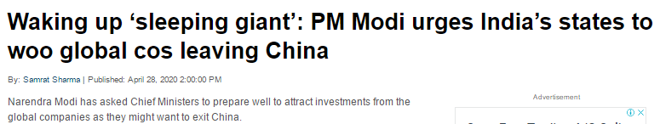
Why should NRI Invest in India
Positive outlook ahead as more foreign companies to invest in India

Slide 10

Why should NRI Invest in India
Indian Equity market has outperformed world equity market in past
Past 15 years
Date | BSE Sensex | FTSE 100 | NYSC Composite | Nikkei 225 | Dow Jones | Hang Seng | Straits Times
Jan’ 2005 | 6626 | 4814 | 7250 | 11458 | 10784 | 14216 | 2065
Dec’ 2019 | 41254 | 7542 | 13913 | 23771 | 28538 | 28190 | 3223
Annualized return | 12.96% | 3.04% | 4.44% | 4.98% | 6.70% | 4.67% | 3.01%
Past 20 years
Date | BSE Sensex | FTSE 100 | NYSC Composite | Nikkei 225 | Dow Jones | Hang Seng | Straits Times
Jan’ 2000 | 5210 | 6930 | 6762 | 18937 | 11502 | 17058 | 2502
Dec’ 2019 | 41254 | 7542 | 13913 | 23771 | 28538 | 28190 | 3223
Annualized return | 10.89% | 0.42% | 3.67% | 1.14% | 4.65% | 2.54% | 1.27%

Slide 11

Why should NRI Invest in India
Higher interest rates in India at present than other countries
India | USA | UK | UAE | Australia | New Zealand | Singapore | China
6.00% | 0.06% | 0.35% | 0.50% | 1.00% | 1.30% | 1.40% | 2.75%
*Maximum Interest rates offered by leading Banks for Term Deposits

Slide 12
Products

Slide 13



Smart Wealth Plan –Lump sum Benefit Option
Need
Identified:
Build a corpus
for his
Daughter’s
Education
Daughter’s
Details:
Name: Ria
LI Age: 2 Years
Solution:
Max Life
Smart
Wealth
Plan
Mr. Ravi,
Age: 35 Years
PPT: 8 years
PT: 16 years
Premium:
10 Lac p.a.
Mr. Ravi & his Daughter
1
2
3
8
Policy Term
Ends
. . . . . . . . .
Policy
Commencement
Age:
35 Years
Age:
51 Years
Rs. 1,60,67,600
(Rs. 1.60 cr)
Guaranteed Maturity Benefit
. . . . . . . .
Annual Premium Paid = Rs. 10 Lac
Total Premium Paid in 8 years (10*8) = Rs. 80 Lacs

Slide 14



Smart Wealth Plan - Long Term Income Benefit Option
Need
Identified:
Wants guaranteed
income to fulfill his
Early Retirement
needs
Solution:
Max Life
Smart
Wealth
Plan
Mr. Agrim,
Age: 35 Years
PPT: 10 years
Premium:
5 Lacs p.a.
Mr. Agrim
Rs. 4.74 Lacs of Guaranteed Income every year for 25 Years
+ Rs. 50 Lacs as Terminal Benefit
Policy
Term
Ends
+
1
2
3
. . . . . . . . . . . . . . . . . .
10
. . . . . . . . . . . . . . . . . . .
12
15
16
. . . . . . . . . . . . . . . . . . .
36
Terminal Benefit (Total Premiums Paid)
Age:
35 Years
. . . . . . . . . . . . . . . . . .
Age:
71 Years
Annual Premium Paid = Rs. 5 Lac
Total Premium Paid in 10 years = Rs. 50 Lacs

Slide 15








MONTHLY INCOME ADVANTAGE PLAN
LIVING BENEFITS
Guaranteed Monthly Income for 10 years = Rs 1,25,000
Annualized Premium : Rs 10,03,500
Total Premium Paid: Rs 12,042,000.00
Lump- sum payable at Maturity
@4% = Rs 9,73,896
@8% = Rs 1,19,22,959
Year 1
Age: 35 years
Year 13
Age: 47 years
Year 22
Age: 56 years
End of Premium Paying term
Death benefit = 1,50,00,000
Guaranteed Monthly Income for 10 years = Rs 1,25,000
DEATH BENEFITS
Lump- sum payable at Maturity
@4% = Rs 9,73,896
@8% =Rs 1,19,22,959
Annualized Premium : Rs 10,03,500
Total Premium Paid: Rs 5,017,500
Future premiums due from year 6 to year 12 are waived off by Max life
Year 1
Age: 35 years
Annualized Income :Rs 15,00,000
Total Income : Rs 150,00,000
Year 5
Age: 40 years
Year 13
Year 22
End of Premium Paying term

Slide 16


Platinum Wealth Plan – 5 Pay 10
Name: Rahul
Age: 35
Male; Non Smoker
Annual Premium : Rs 10,00,000
Total Premium : Rs 50,00,000
End of Premium Paying Term
Maturity Benefit @8% : Rs 81,00,405
Year 1
Year 5
Year 10
Age: 35
Age: 40
Age: 45
Annual Premium : Rs 10,00,000
Total Premium : Rs 50,00,000
End of Premium Paying Term
Death Benefit: Rs 1,00,00,000
Year 1
Year 5
Year 10
Age: 35
Age: 40
Age: 45
6

